Slide 1
8. Recursion
1.1–1.2
Notes:
Learning Objectives
(8.1a) Determine the purpose or output of a recursive method by tracing the program code.
(8.1b) Compare the readability and efficiency of iterative and recursive solutions to the same problem.
(8.1c) Identify the base case and general case for a recursive solution.
(8.1d) Design and implement a recursive method to solve a problem.
(8.1e) Explain and illustrate the call stack developed in a recursive solution to a problem.
(8.1f) Check and test a recursive method for correctness.

Slide 2
8. Recursion
Foundations
A classic example
Adopted and modified from Slides by Sedgewick and Wayne

Slide 3
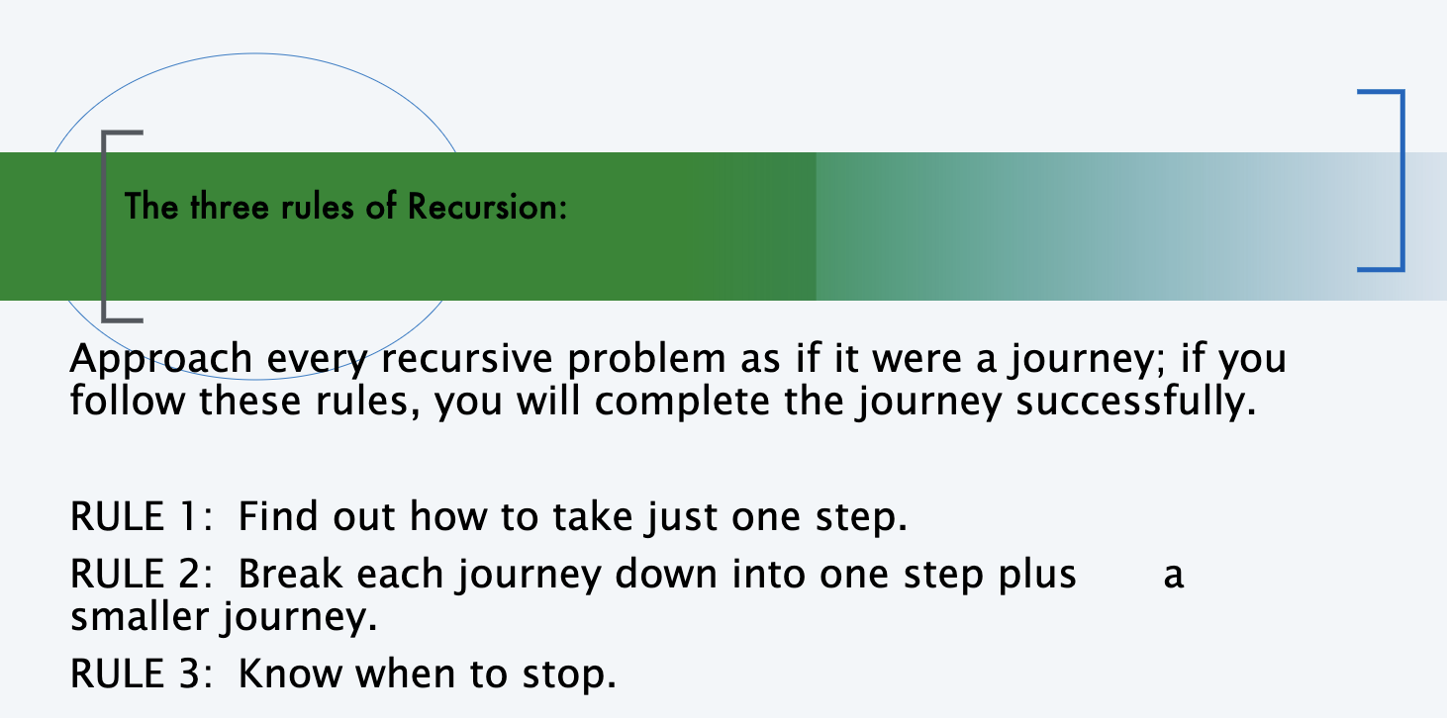

Slide 4
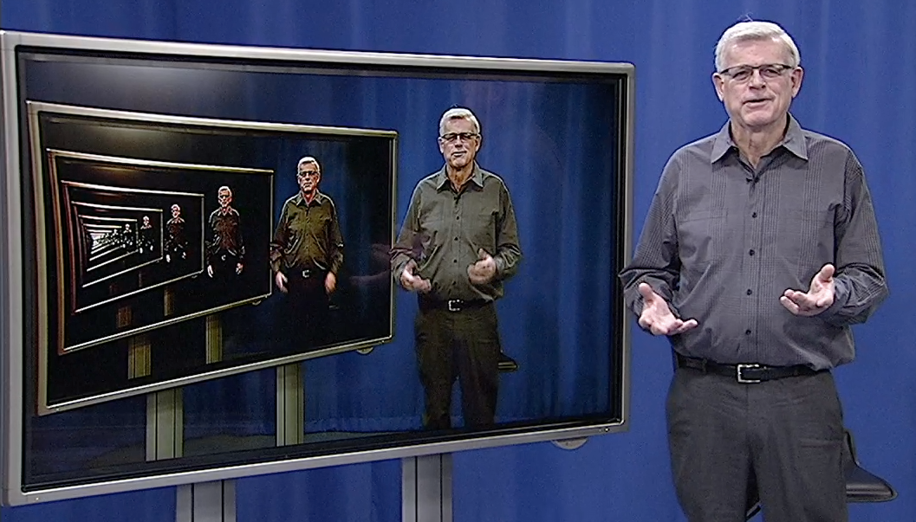
Overview
Q. What is recursion?
A. When something is specified in terms of itself.
Why learn recursion?
Represents a new mode of thinking.
Provides a powerful programming paradigm.
Enables reasoning about correctness.
Gives insight into the nature of computation.
Many computational artifacts are naturally self-referential.
File system with folders containing folders.
Fractal graphical patterns.
Divide-and-conquer algorithms (stay tuned).

Slide 5
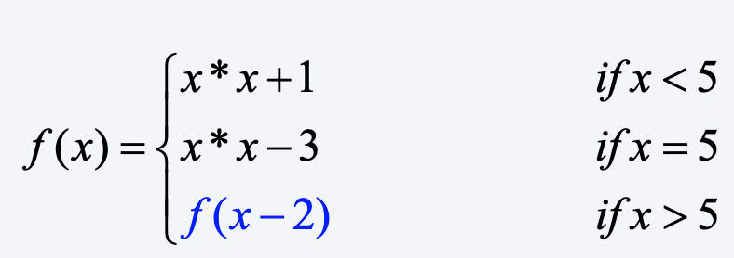
A mathematics example…
Find f(0) and f(6)

Slide 6
Comparing recursive solutions to iterative solutions...
Iterative
for(int i=0; i<=5; i++)
System.out.println(i);
Recursive
public static void printNumber(int n) {
if (n>=0) {
printNumber(n-1);
System.out.println(n);
}
}
call: printNumber(5);

Slide 7
Comparing recursive solutions to iterative solutions...Factorial
Iterative
public static int factorial(int n){
int product = 1;
for(int i= 1; i<= n; i++){
product *= i;
}
return product;
}
Recursive
public static int factorial(int n){
if (n == 0 || n == 1){
return 1;
}
else {
return n * factorial(n-1);
}
}

Slide 8
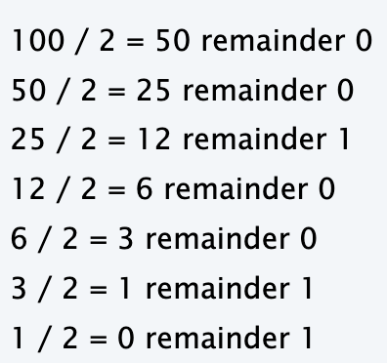
Example: Converting decimal to binary
Here is the method for converting and printing the decimal number 100 to a binary number (base 2):
Now, let's look at this same problem recursively.
First, know how to take one step:
A step seems to be "Divide by 2; Note the quotient and the remainder”
Second, break each problem down into one step plus a smaller problem:
The quotient is smaller than the original number.
The above process is now done with the quotient.
Therefore I have a smaller problem.
Know how and when to stop:
Stop when the quotient is 0.
Actually, the recursion stops when the quotient <= 0.
Print out the remainders when I finally have a quotient of 0. The last remainder must be written first.

Slide 9
Example: Convert an integer to binary
public class Binary
{
public static String Rconvert(int N)
{
if (N == 1) return "1";
return Rconvert(N / 2) + (N % 2);
}
public static void main(String[] args)
{
int N = Integer.parseInt(args[0]);
StdOut.println(Rconvert(N));
}
}
Recursive program
To compute a function of a positive integer N
Base case. Return a value for small N .
Reduction step. Assuming that it works for smaller values of its argument, use the function to compute a return value for N.
int 0 or 1
automatically
converted to
String "0" or "1"
% java Binary 6
110
% java Binary 37
100101
% java Binary 999999
11110100001000111111

Slide 10
Recursion versus iteration
Compare the readability and efficiency of iterative and recursive solutions to the same problem.
LO 8.1b
Fact. Any recursive solution can be converted to an equivalent iterative solution.
Pros. Iterative solution can be more efficient
Cons. Iterative solution can be less elegant.
public static String Rconvert(int N)
{
if (N == 1) return "1";
return Rconvert (N / 2) + (N % 2);
}
public static String Iconvert(int N)
{
String outString = “”;
for (int i = N; i > 0; i = i / 2) {
outString = i % 2 + outString;
}
return outString;
}
recursive solution
Q. How can we find an iterative solution to the same problem?
Iterative solution
A. Recursion is inherently iterative. It calls itself, until the base condition is met. Therefore it is always possible to find an iterative solution (one function call) versus an iterative solution (many function calls)
Notes:
(8.1b) Compare the readability and efficiency of iterative and recursive solutions to the same problem.

Slide 11
Base case versus general case
Identify the base case and general case for a recursive solution.
LO 8.1c
public static int Fib(int N) {
if (N == 0 || N == 1) return "1";
else
return Fib(N-1) + Fib(N-2);
}
public static int Fib(int N) {
if (N == 0 || N == 1) return "1";
else {
int prev = 1, prevprev = 1, next;
for (int i=2; i<=N; i++) {
next = prev + prevprev;
prevprev = prev;
prev = next;
}
return next;
}
Important. Any recursive solution must be described using one or more base cases and a general c
Base case. Defines the conditions for termination of recursive calls
General case. Defines the most general description of the solution
recursive solution
Example. Given an integer N, print the first N^{th}, Fibonacci (Fib) number.
Base case(s). If N=1 or N=0, then the Fib(N) is 1
General case. If N >= 2, then
Fib(N) = Fib(N-1) + Fib(N-2)
Iterative solution
Notes:
(8.1c) Identify the base case and general case for a recursive solution.

Slide 12
Mechanics of a function call
Explain and illustrate the call stack developed in a recursive solution to a problem.
LO 8.1e
System actions when any function is called
Save environment (values of all variables and call location).
Initialize values of argument variables.
Transfer control to the function.
Restore environment (and assign return value)
Transfer control back to the calling code.
Rconvert(26)
if (N == 1) return "1";
return Rconvert(13) + "0";
"1101"
Rconvert(13)
if (N == 1) return "1";
return Rconvert(6) + "1";
Rconvert(6)
if (N == 1) return "1";
return Rconvert(3) + "0";
"110"
public class Binary
{
public static String Rconvert(int N)
{
if (N == 1) return "1";
return Rconvert(N / 2) + (N % 2);
}
public static void main(String[] args)
{
int N = Integer.parseInt(args[0]);
System.out.println(Rconvert(N));
}
}
Rconvert(3)
if (N == 1) return "1";
return Rconvert(1) + "1";
"11"
Rconvert(1)
if (N == 1) return "1";
return Rconvert(0) + "1";
"1"
% java Rconvert 26
11010
Notes:
(8.1e) Explain and illustrate the call stack developed in a recursive solution to a problem.

Slide 13

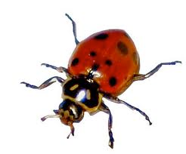


Programming with recursion: typical bugs
Missing base case
public static double bad(int N)
{
return bad(N-1) + 1.0/N;
}
No convergence
guarantee
public static double bad(int N)
{
if (N == 1) return 1.0;
return bad(1 + N/2) + 1.0/N;
}
Try N = 2s
Both lead to infinite recursive loops (bad news).
need to know
how to stop them
on your computer

Slide 14
8. Recursion
Foundations
Classic examples

Slide 15
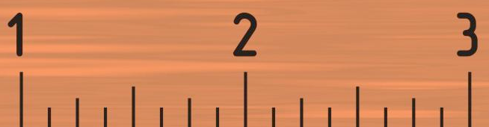
Warmup: subdivisions of a ruler (revisited)
Design and implement a recursive method to solve a problem.
LO 8.1d
ruler(n): create subdivisions of a ruler to 1/2^{n} inches.
Return one space for n = 0.
Otherwise, sandwich n between two copies of ruler(n-1).
1 2 1 3 1 2 1 4 1 2 1 3 1 2 1
public class Ruler
{
public static String ruler(int n)
{
if (n == 0) return " ";
return ruler(n-1) + n + ruler(n-1);
}
public static void main(String[] args)
{
int n = Integer.parseInt(args[0]);
StdOut.println(ruler(n));
}
}
% java Ruler 1
1
% java Ruler 2
1 2 1
% java Ruler 3
1 2 1 3 1 2 1
% java Ruler 4
1 2 1 3 1 2 1 4 1 2 1 3 1 2 1
% java Ruler 50
Exception in thread "main" java.lang.OutOfMemoryError: Java heap space
2⁵⁰ − 1 integers in output.
Notes:
(8.1d) Design and implement a recursive method to solve a problem.
good style to declare loop iteration variable in initialization statement.
Example of automatic type conversion from integer to string.

Slide 16
Tracing a recursive program
Determine the purpose or output of a recursive method by tracing the program code.
LO 8.1a
Use a recursive call tree
One node for each recursive call.
Label node with return value after children are labeled.
ruler(4)
1 2 1 3 1 2 1 4 1 2 1 3 1 2 1
ruler(3)
1 2 1 3 1 2 1
1 2 1 3 1 2 1
ruler(2)
1 2 1
1 2 1
1 2 1
1 2 1
ruler(1)
1
1
1
1
1
1
1
1
ruler(0)
⎵
⎵
⎵
⎵
⎵
⎵
⎵
⎵
⎵
⎵
⎵
⎵
⎵
⎵
⎵
⎵
Notes:
(8.1a) Determinethe purpose or output of a recursive method by tracing the program code.

Slide 17

Example: Towers of Hanoi puzzle (https://www.mathsisfun.com/games/towerofhanoi.html)
A legend of uncertain origin
n = 64 discs of differing size; 3 posts; discs on one of the posts from largest to smallest.
An ancient prophecy has commanded monks to move the discs to another post.
When the task is completed, the world will end.
n = 10
Rules
Move discs one at a time.
Never put a larger disc on a smaller disc.
before
Q. Generate list of instruction for monks ?
after
Q. When might the world end ?

Slide 18
Towers of Hanoi
For simple instructions, use cyclic wraparound
Move right means
Move left means
1 to 2,
2 to 3,
or 3 to 1.
1 to 3,
3 to 2,
or 2 to 1.
0
1
2
1
2
3
A recursive solution
Move n − 1 discs to the left (recursively).
Move largest disc to the right.
Move n − 1 discs to the left (recursively).

Slide 19
Towers of Hanoi solution (n = 3)
1R
2L
1R
3R
1R
1R
2L
1R
3R
1R
2L
1R
2L
1R

Slide 20
Towers of Hanoi: recursive solution
hanoi(n): Print moves for n discs.
Return one space for n = 0.
Otherwise, set move to the specified move for disc n.
Then sandwich move between two copies of hanoi(n-1).
public class Hanoi
{
public static String hanoi(int n, boolean left)
{
if (n == 0) return " ";
String move;
if (left) move = n + "L";
else move = n + "R";
return hanoi(n-1, !left) + move + hanoi(n-1, !left);
}
public static void main(String[] args)
{
int n = Integer.parseInt(args[0]);
StdOut.println(hanoi(n, false));
}
}
% java Hanoi 3
1R 2L 1R 3R 1R 2L 1R
Notes:
good style to declare loop iteration variable in initialization statement.
Example of automatic type conversion from integer to string.

Slide 21
Recursive call tree for towers of Hanoi
Structure is the same as for the ruler function and suggests 3 useful and easy-to-prove facts.
Each disc always moves in the same direction.
Moving smaller disc always alternates with a unique legal move.
Moving n discs requires 2^{n} − 1 moves.
hanoi(4, true)
1 2 1 3 1 2 1 4 1 2 1 3 1 2 1
R L R R R L R L R L R R R L R
hanoi(3, false)
1 2 1 3 1 2 1
R L R R R L R
1 2 1 3 1 2 1
R L R R R L R
hanoi(2, true)
1 2 1
R L R
1 2 1
R L R
1 2 1
R L R
1 2 1
R L R
hanoi(1, false)
1
R
1
R
1
R
1
R
1
R
1
R
1
R
1
R
hanoi(0, true)
⎵
⎵
⎵
⎵
⎵
⎵
⎵
⎵
⎵
⎵
⎵
⎵
⎵
⎵
⎵
⎵

Slide 22
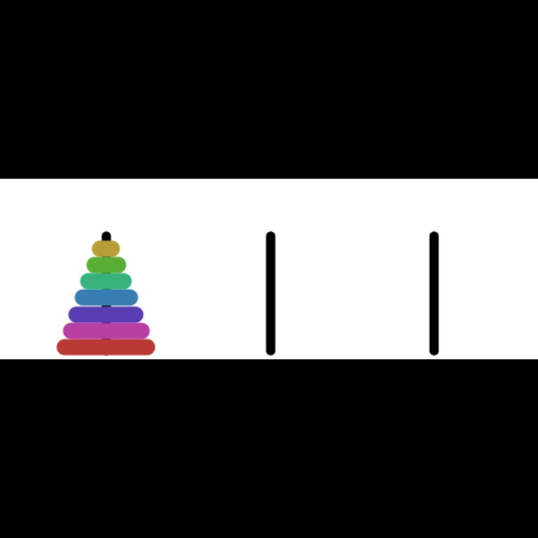
Answers for towers of Hanoi
Q. Generate list of instructions for monks ?
A. (Long form). 1L 2R 1L 3L 1L 2R 1L 4R 1L 2R 1L 3L 1L 2R 1L 5L 1L 2R 1L 3L 1L 2R 1L 4R ...
A. (Short form). Alternate "1L" with the only legal move not involving the disc 1.
"L" or "R" depends on whether n is odd or even
Q. When might the world end ?
moves per second | end of world
1 | 5.84 billion centuries
1 billion | 5.84 centuries
A. Not soon: need 2⁶⁴ − 1 moves.
Note: Recursive solution has been proven optimal.

Slide 23
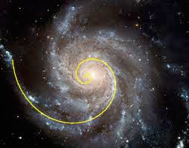
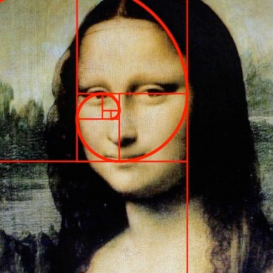

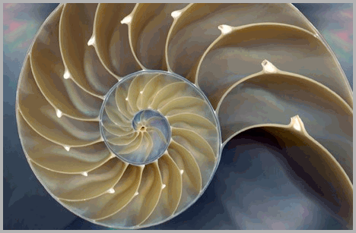
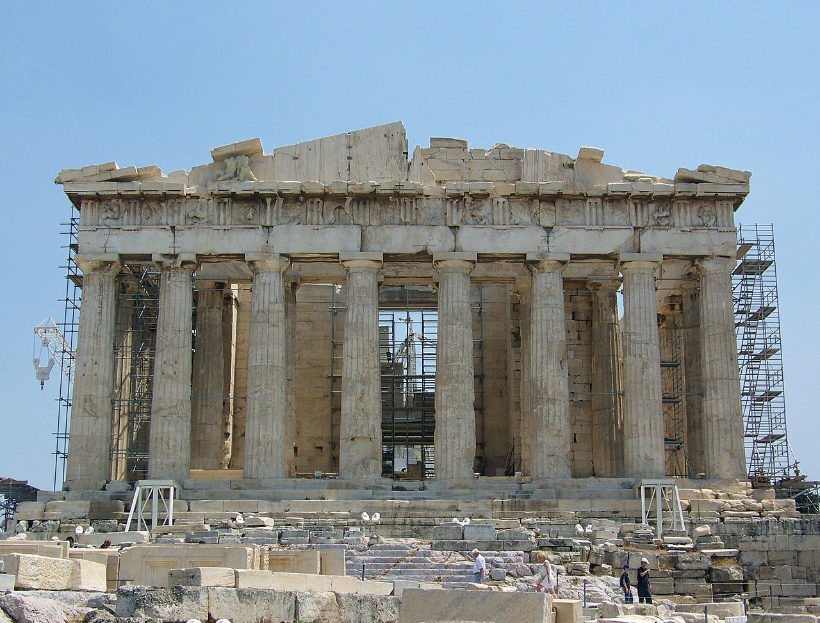
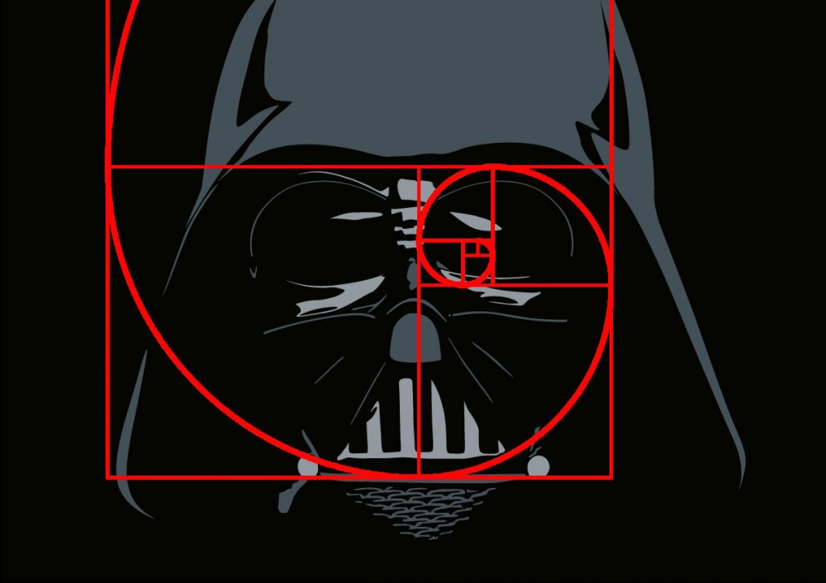
Fibonacci numbers and the golden ratio in the wild
1
1
2
3
5
8
13
21
1
1 1
1 2 1
1 3 3 1
1 4 6 4 1
1 5 10 10 5 1
1 6 15 20 15 6 1
1 7 21 35 35 21 7 1

Slide 24
Example: Computing Fibonacci numbers
Q. [Curious individual.] What is the exact value of F60 ?
A. [Novice programmer.] Just a second. I'll write a recursive program to compute it.
public class FibonacciR
{
public static long F(int n)
{
if (n == 0) return 0;
if (n == 1) return 1;
return F(n-1) + F(n-2);
}
public static void main(String[] args)
{
int n = Integer.parseInt(args[0]);
StdOut.println(F(n));
}
}
% java FibonacciR 5
5
% java FibonacciR 6
8
% java FibonacciR 10
55
% java FibonacciR 12
144
% java FibonacciR 50
12586269025
% java FibonacciR 60
takes a few minutes
Hmmm. Why is that?
Is something wrong with my computer?

Slide 25
Recursive call tree for Fibonacci numbers
F(6)
8
F(5)
5
F(4)
3
3
F(3)
2
2
2
F(2)
1
1
1
1
1
F(1)
1
1
1
1
1
1
1
1
F(0)
0
0
0
0
0

Slide 26
Practice: What is printed?
public static void mysteryXY(int x, int y) {
if (y == 1) {
System.out.print(x);
} else {
System.out.print(x * y + ", ");
mysteryXY(x, y -1);
System.out.print(", " + x * y);
}
}
1. mysteryXY(4, 1)
2. mysteryXY(4, 2)
3. mysteryXY(4, 3)
4. mysteryXY(3, 4)

Slide 27
Practice: Recursion with Arrays
Recursive Sum
Return the sum of elements in A[0…N-1] using recursion
public static int findSum(int A[], int n){
//your code here
}

Slide 28
Practice: Recursion with Arrays
Recursive Minimum
If there is a single element, return it;
Else, return the minimum of the following:
Last element
Value returned by recursive call for n-1 elements

Slide 29
Practice: Recursion with Arrays
Array11
Given an array of ints, compute recursively the number of times that the value 11 appears in the array. We'll use the convention of considering only the part of the array that begins at the given index. In this way, a recursive call can pass index+1 to move down the array. The initial call will pass in index as 0.
array11([1, 2, 11], 0) →1
array11([11, 11], 0) →2
array11([1, 2, 3, 4], 0) →0
public int array11(int[] nums, int index) {
//your code here
}
https://codingbat.com/prob/p107330

Slide 30
Example: Count7s
Given a non-negative int n, return the count of the occurrences of 7 as a digit, so for example 717 yields 2. Compute recursively (no loops). Note that mod (%) by 10 yields the rightmost digit (126 % 10 is 6), while divide (/) by 10 removes the rightmost digit (126 / 10 is 12).
count7(717) →2
count7(7) →1
count7(123) →0
public int count7(int n) {
//your code here
}

Slide 31
Example: BunnyEars
We have bunnies standing in a line, numbered 1, 2, ... The odd bunnies (1, 3, ..) have the normal 2 ears. The even bunnies (2, 4, ..) we'll say have 3 ears, because they each have a raised foot. Recursively return the total number of "ears" in the bunny line 1, 2, ... n (without loops or multiplication).
bunnyEars2(0) →0
bunnyEars2(1) →2
bunnyEars2(2) →5
https://codingbat.com/prob/p107330

Slide 32
MORE PRACTICE:
CodingBat
https://codingbat.com/java/Recursion-1
Practice It!
https://practiceit.cs.washington.edu/problem/list
Chapter 12

Slide 33
Image sources
http://upload.wikimedia.org/wikipedia/en/7/7a/Richard_Ernest_Bellman.jpg
http://apprendre-math.info/history/photos/Polya_4.jpeg
http://www.advent-inc.com/documents/coins.gif
http://upload.wikimedia.org/wikipedia/commons/a/a0/2006_Quarter_Proof.png
http://upload.wikimedia.org/wikipedia/commons/3/3c/Dime_Obverse_13.png
http://upload.wikimedia.org/wikipedia/commons/7/72/Jefferson-Nickel-Unc-Obv.jpg
http://upload.wikimedia.org/wikipedia/commons/2/2e/US_One_Cent_Obv.png
Image sources
http://en.wikipedia.org/wiki/Fibonacci
http://www.inspirationgreen.com/fibonacci-sequence-in-nature.html
http://www.goldenmeancalipers.com/wp-content/uploads/2011/08/mona_spiral-1000x570.jpg
http://www.goldenmeancalipers.com/wp-content/uploads/2011/08/darth_spiral-1000x706.jpg
http://en.wikipedia.org/wiki/Ancient_Greek_architecture#mediaviewer/ File:Parthenon-uncorrected.jpg
https://openclipart.org/detail/184691/teaching-by-ousia-184691
Image sources
http://en.wikipedia.org/wiki/Droste_effect#mediaviewer/File:Droste.jpg
http://www.mcescher.com/gallery/most-popular/circle-limit-iv/
http://www.megamonalisa.com/recursion/
http://fractalfoundation.org/OFC/FractalGiraffe.png
http://www.nytimes.com/2006/12/15/arts/design/15serk.html?pagewanted=all&_r=0
http://www.geocities.com/aaron_torpy/gallery.htm

Slide 34
8. Recursion
Foundations
A classic example

Slide 35
8. Recursion
Section 2.3

